Slide 1
QF604: Econometrics of Financial Markets
Jin, Kim, Quek, Wang and Woon (2019)

Slide 2
The Dow Jones Utility Average & Smart Beta Alternatives
Introduction
Data Sources & Preparation
Smart Beta Index Construction, Methodology & Initial Findings
Index Performance Appraisal
Autocorrelation of Fundamentals
Further Regression Studies
Conclusion

Slide 3
Introduction
1

Slide 4
Introduction
The Dow Jones Utility Average (DJUA), a member of the Dow Jones Global Indexes, was created in 1929 when utility stocks were removed from the Dow Jones Industrial Average.
The DJUA tracks the overall performance of a small group of 15 utility stocks traded in the U.S. by using a price-weighted average method.
Constituent companies are primarily producers of utility resources such as electricity and natural gas.

Slide 5
Introduction
In addition, these utility companies typically pay sizable dividends and provide a steady stream of dividend income relative to companies from other sectors as they face less uncertainty and minimal future volatility due to nature of their industry.
This therefore results in utility sector stocks to be typically seen as a favourite for retirees and other income-seeking investors.
In hope of constructing an index that outperforms the price-weighted DJUA, our team decided to construct smart-beta indices which weigh constituent stocks by fundamentals instead of price. We then analysed and appraised the findings of our endeavour.

Slide 6
Data Sources & Preparation
2

Slide 7
Data Sources & Preparation
Our data sample includes stock and relevant fundamentals data on all stocks which have ever been members of the Dow Jones Utility Average index for the period between 1963 and 2018 (the sample period).
We obtained the bulk of our data from Wharton Research Data Services (WRDS), from which the Center for Research in Security Prices (CRSP), Compustat - Capital IQ and CRSP/Compustat Merged Database (CCM) databases were utilised.
We also tapped on the Bloomberg database for index price data and membership data on the Dow Jones Utility Average, though the information provided was incomplete and was supplemented by information from this article by Global Financial Data.

Slide 8
Center for Research in Security Prices (CRSP)
The Center for Research in Security Prices (CRSP) provided us with relevant data on:
Monthly closing price,
Adjusted returns
Outstanding number of stocks.
PERMCOs and PERMNOs as unique entity and issue-level identifiers when navigating the CRSP database.

Slide 9
Compustat - Capital IQ
Compustat provided us with the relevant fundamentals data (e.g. Net Income, Operating Cash Flow etc) on the relevant constituent stocks of the Dow Jones Utility Average.
We used GVKEY as unique entity-level identifiers when navigating the Compustat database.

Slide 10
CRSP/Compustat Merged Database (CCM)
We used the CCM Database to obtain the links between the unique PERMCO and GVKEY identifiers for the CRSP and Compustat databases respectively.
This allowed us to be able to link stock price and market capitalisation data to other corresponding fundamentals (e.g. computed ROCE, ROA numbers) data at the entity level. With that said, not all required data was found to be available for our sample period.

Slide 11
Computation of Fundamentals
Description | Equation | Price Return Index | Total Return Index | Comments
Market Capitalisation | Share Price x No. of Shares Outstanding | Yes | Yes
Return on Assets | Net Income/Total Assets | Yes | Yes
Return on Capital Employed | EBIT/Capital Employed | Yes | Yes | Capital Employed = Total Assets - Current Liabilities
Return on Invested Capital | NOPAT/Invested Capital | Yes | Yes | NOPAT = EBIT x (1-Tax Rate)
Gross Margin | Gross Profit/Revenue | Yes | Yes
Profit Margin | Net Income/Revenue | Yes | Yes
EBITDA Margin | EBITDA/Revenue | Yes | Yes
Operating Cash Flow Margin | Operating Cash Flow/Revenue |  | Yes
Current Ratio | Current Assets/Current Liabilities | Yes | Yes
Long Term Debt to Total Equity | Long Term Debt/Total Equity | Yes | Yes

Slide 12
Some Data Constraints
We only started our smart beta Total Return indices from June 1988 owing to a lack of prior price data on the relevant benchmark index (the Dow Jones Utility Average Total Return) and on Operating Cash Flow Margin fundamentals data.
As can be inferred, owing to a lack of data, price return smart beta indices based on Operating Cash Flow Margin were not constructed.

Slide 13
Smart Beta Index Construction, Methodology & Initial Findings
3

Slide 14
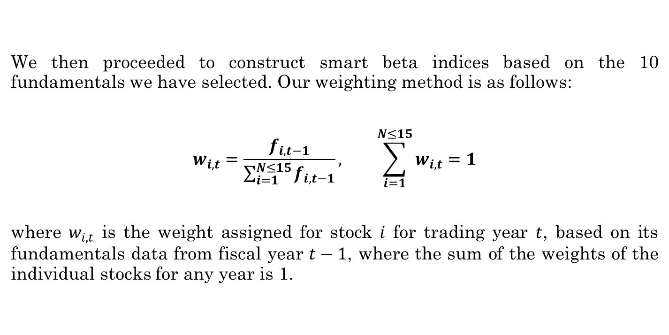
Weighting Method
We then proceeded to construct smart beta indices based on the 10 fundamentals we have selected. Our weighting method is as follows:
$$w_{i,t}=\frac{f_{i,t−1}}{\sum_{i=1}^{N≤15}{f_{i,t−1}}}, \sum_{i=1}^{N≤15}{w_{i,t}}=1$$
where $w_{i,t}$ is the weight assigned for stock $i$ for trading year $t$, based on its fundamentals data from fiscal year $t−1$, where the sum of the weights of the individual stocks for any year is 1.

Slide 15
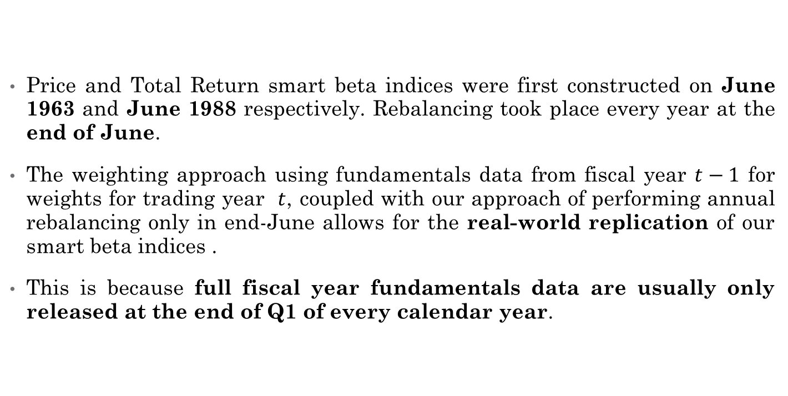
Real-World Replicability
Price and Total Return smart beta indices were first constructed on June 1963 and June 1988 respectively. Rebalancing took place every year at the end of June.
The weighting approach using fundamentals data from fiscal year $t−1$ for weights for trading year $t$, coupled with our approach of performing annual rebalancing only in end-June allows for the real-world replication of our smart beta indices .
This is because full fiscal year fundamentals data are usually only released at the end of Q1 of every calendar year.

Slide 16
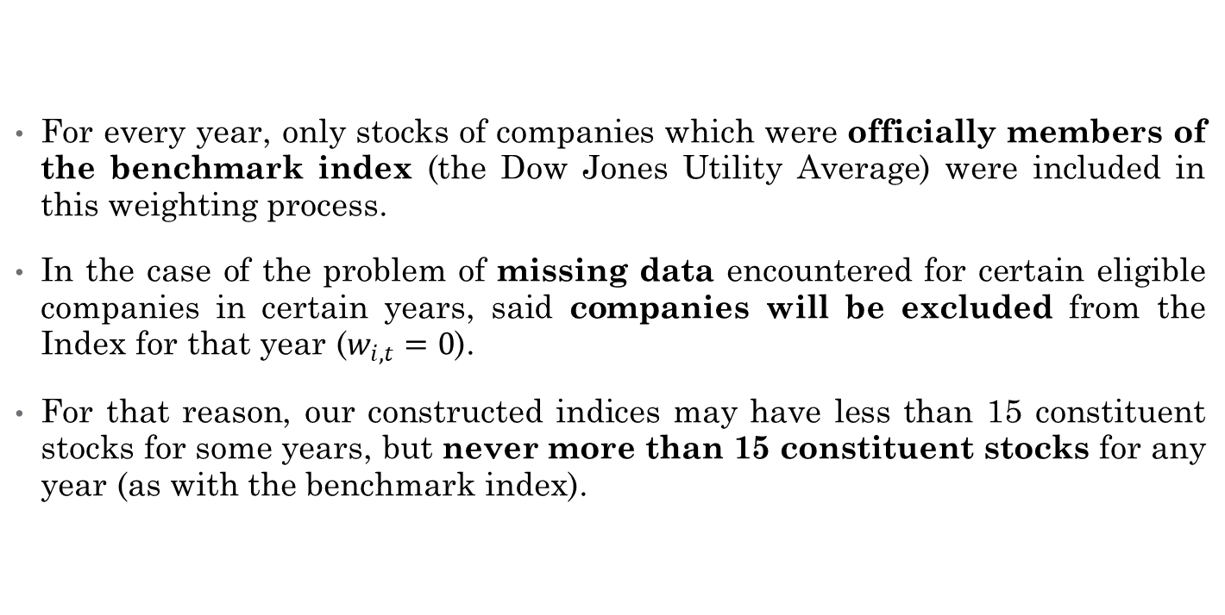
Just Some Rules..
For every year, only stocks of companies which were officially members of the benchmark index (the Dow Jones Utility Average) were included in this weighting process.
In the case of the problem of missing data encountered for certain eligible companies in certain years, said companies will be excluded from the Index for that year ($w_{i,t}=0$).
For that reason, our constructed indices may have less than 15 constituent stocks for some years, but never more than 15 constituent stocks for any year (as with the benchmark index).

Slide 17
Just Some More Rules..
Given how some of our chosen fundamentals (e.g. ROA, ROCE, ROIC etc) can take on negative values, we allowed our indices to be fully unconstrained.
This means that long or short positions on eligible stocks were permitted with no set limits.
We also established an “absorbing state” for the prices of the smart beta indices to be at 0 (indicating a total loss of initial capital), with any of our indices reaching or exceeding that floor deemed to be failed ones and as such excluded from further analysis.

Slide 18
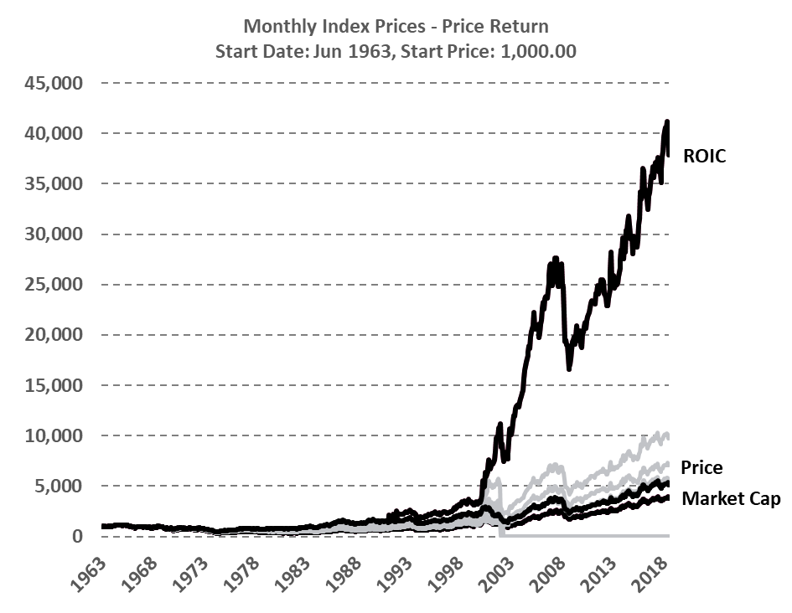
Initial Findings
The superior smart beta index become clear as day after the computed smart beta index prices were plotted over time.
For both price return and total return smart beta portfolios, the portfolios with ROIC-based weightings achieved far superior returns over our other constructed indices.

Slide 19
CRSP
Available Relevant Data (Monthly)
Closing Stock Price
Number of Shares Outstanding
Returns (Simple, Dividend, Delisting)
Identifiers
PERMCO
PERMNO
CUSIP – Not unique
Ticker – Not unique

Slide 20
Compustat – Capital IQ
Available Relevant Data (Balance Sheet, Annual)
Total Stockholders’ Equity
Deferred Taxes
Investment Tax Credit
Preferred Stock (Redemption, Liquidation, Carrying Values)
Identifiers
GVKEY
IID
CUSIP – Not unique
Ticker – Not unique, different from CRSP tickers

Slide 21
CRSP vs Compustat
Entity Level: PERMCO (CRSP) and GVKEY (Compustat) do not always agree, difficult to obtain perfect matching between datasets. As such, 1 PERMCO may correspond to multiple GVKEY and vice versa.
CRSP/Compustat Merged (CCM) tries to bridge the gap but some crucial data (e.g. number of shares outstanding) is missing/formatted in an inconvenient manner.
Solution: Use CCM to obtain entity level matching data, then raw data was obtained from standalone datasets. New identifier GVKEY PERMCO was created for purposes of traversing between datasets.
Example: If Apple Inc’s GVKEY is 1690 and its PERMCO is 7, its GV KEY PERMCO is 16907, which is a unique identifier.

Slide 22
Other Issues in Data
Missing Data – E.g. No returns data available when it should be
Incomplete Dataset – CRSP & Compustat do not cover the whole population of NYSE, NASDAQ and Amex traded stocks, only an overlap is available
Repeat Data – Double reporting of same company for same period
Conflicting Data – Standalone CRSP & Compustat vs. CCM
Computational Cost – Takes hours to compute several million cells

Slide 23
Data, Research Design & Methodology
Research Design & Methodology:
Size
Book to Market Equity
SMB & HML
Rm-Rf
Quantile Based Portfolios

Slide 24
Size
Formulas
Size = Market Capitalisation of the Firm at June of time t
Market Capitalisation = Share Price x Number of Shares Outstanding
Small vs. Big
Every year, Sizes of firms traded on the NYSE, NASDAQ and Amex (where available) are computed.
Then, for only NYSE-traded firms, Size is ranked, then the median is used as the distinguisher between Small and Big companies.

Slide 25
Book-to-Market Equity
Formulas
Book-to-Market Equity= BE/ME
Book Common Equity (BE) = (Total Stockholders’ Equity + Deferred Taxes + Investment Tax Credit – Book Value of Preferred Stock) of the Firm at time t-1.
Book Value of Preferred Stock = Redemption, Liquidation or Carrying Value of Preferred Stock, in that order, when available.
Market Common Equity (ME) = Market Capitalisation of the Firm at December of time t-1.
High vs. Low
Every year, positive-only BE-ME for firms traded on the NYSE, NASDAQ and Amex (where available) are computed.
Then, for only NYSE-traded firms, BE-ME is ranked, then cut off points of 30% and 70% are used as distinguishers of Low, Medium and High firms.
Low = Bottom 30%, Medium = Next 40%, High = Top 30%

Slide 26
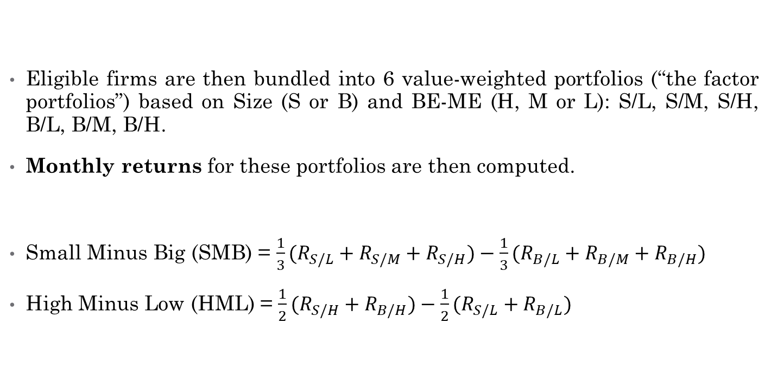
SMB & HML Factors
Eligible firms are then bundled into 6 value-weighted portfolios (“the factor portfolios”) based on Size (S or B) and BE-ME (H, M or L): S/L, S/M, S/H, B/L, B/M, B/H.
Monthly returns for these portfolios are then computed.
Small Minus Big (SMB) = $\frac{1}{3}(R_{S/L}+R_{S/M}+R_{S/H})−\frac{1}{3}(R_{B/L}+R_{B/M}+R_{B/H})$
High Minus Low (HML) = $\frac{1}{2}(R_{S/H}+R_{B/H})−\frac{1}{2}(R_{S/L}+R_{B/L})$

Slide 27
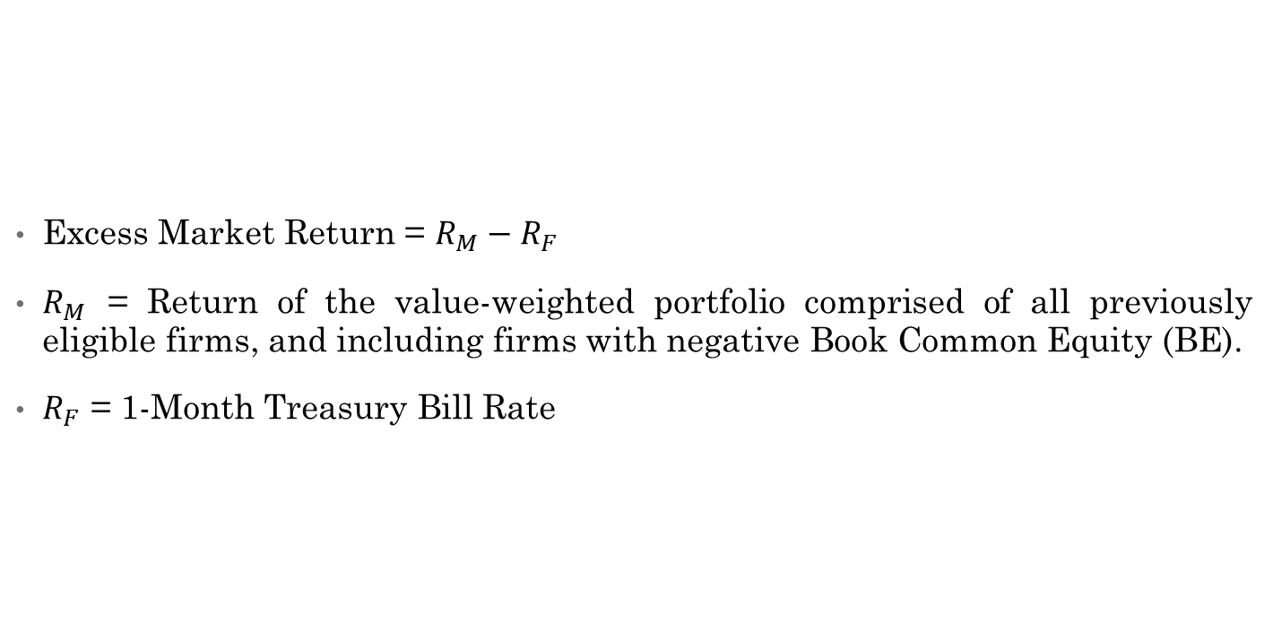
Excess Market Return Factor
Excess Market Return = $R_{M}−R_{F}$
$R_{M}$ = Return of the value-weighted portfolio comprised of all previously eligible firms, and including firms with negative Book Common Equity (BE).
$R_{F}$ = 1-Month Treasury Bill Rate

Slide 28
Quintile-Based Portfolios
The same firms eligible for the 6 factor portfolios are then bundled into 25 portfolios based on their Size and Book-to-Market Equity quintiles.
Again, NYSE-based breakpoints are used to distinguish the firms into their respective quintiles.
Monthly returns for these portfolios are then computed, and regressed against the three Fama-French factors introduced earlier.

Slide 29
Summary of Statistics
4

Slide 30
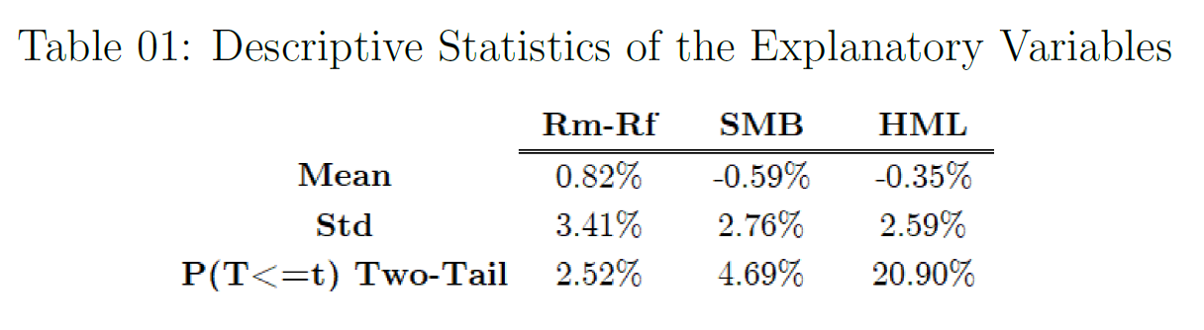
Summary of Statistics
The Explanatory Variables:

Slide 31
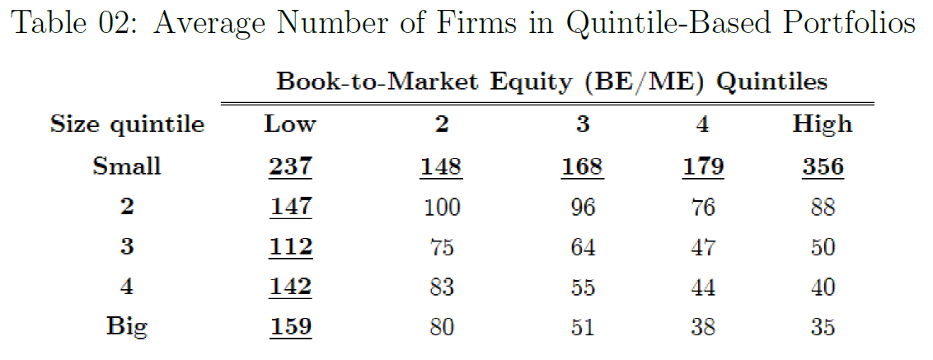
Summary of Statistics
The Dependent Variables:

Slide 32
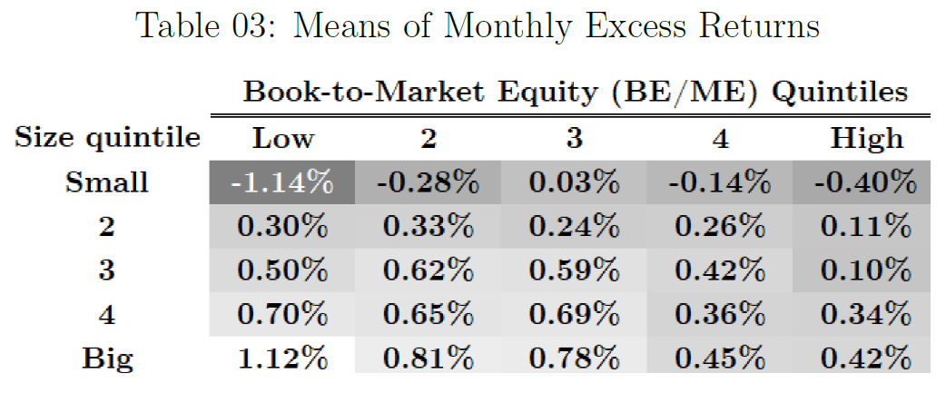
Summary of Statistics
The Dependent Variables:

Slide 33
Regression Analysis
5

Slide 34
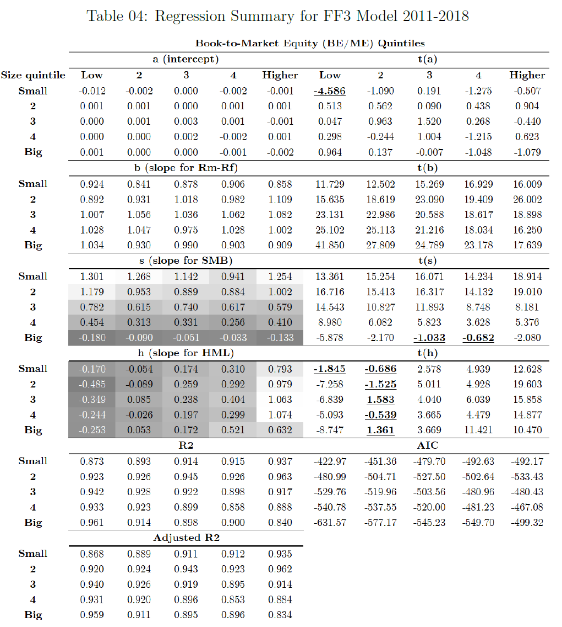
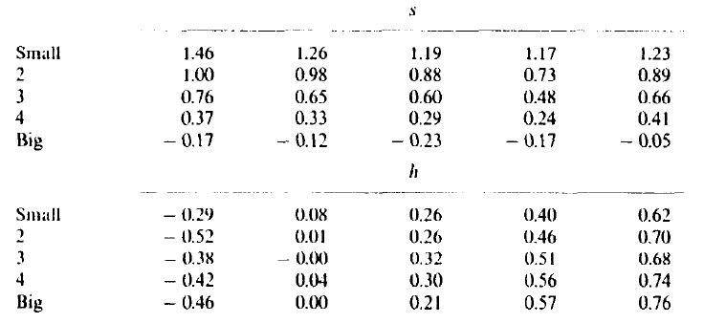
FF3 (2011-2018) vs FF3(1963-1991)

Slide 35
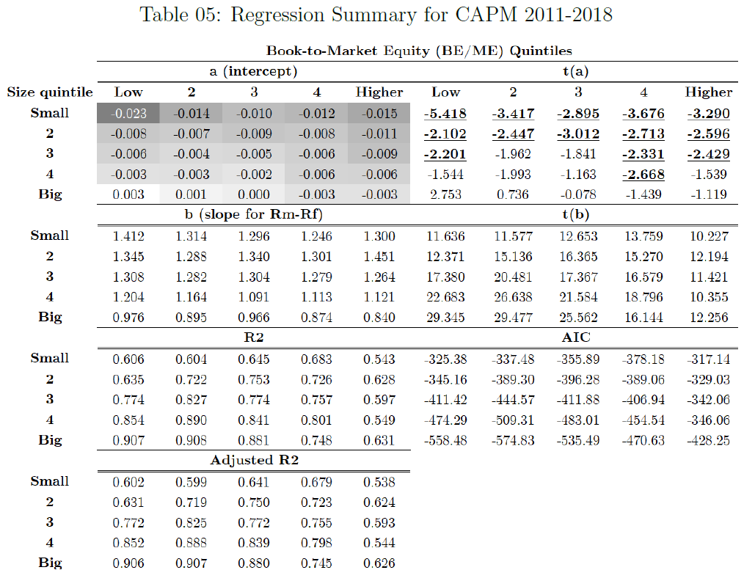
FF3 (2011-2018) vs CAPM(2011-2018)

Slide 36
SMB, HML and UMD: A Deeper Dive
6

Slide 37
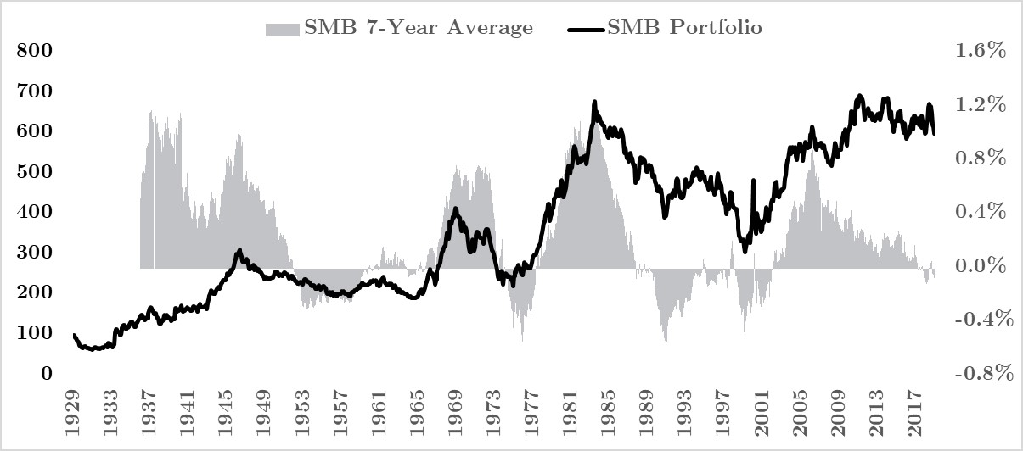
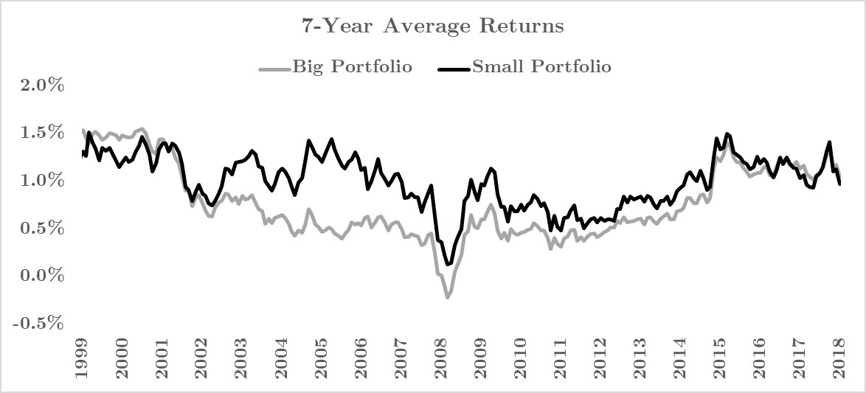
Small Minus Big (SMB) Factor
SMB factor realisations do not exhibit consistently positive readings over our sample period, though said SMB readings are, on average, mildly positive (at 0.21%).
The rolling 7-year SMB average shows how the SMB factor realisations have trended in and out of positive territories over our extended sample period.
Net gain the portfolio has clocked over the extended sample period suggests that SMB factor realisations are still on average, positive.
The sample period used in our main study (July 2011 - December 2018) happens to denote a time period when rolling 7-year average SMB factor realisations are negative, explaining the divergence.
Delving deeper, we found the main driver behind the recent downtrend in rolling 7-year average SMB factor realisations stem mainly from movements in rolling 7-year Big portfolio returns.

Slide 38
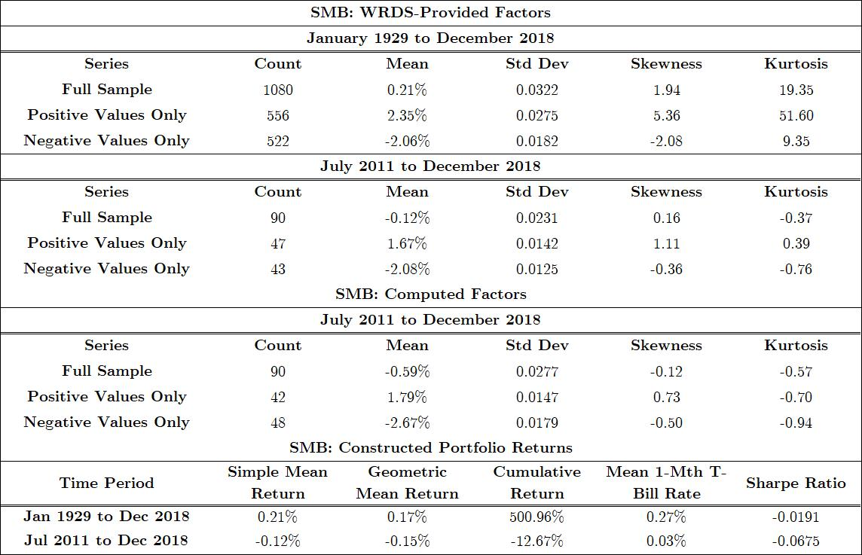
Small Minus Big (SMB) Factor

Slide 39
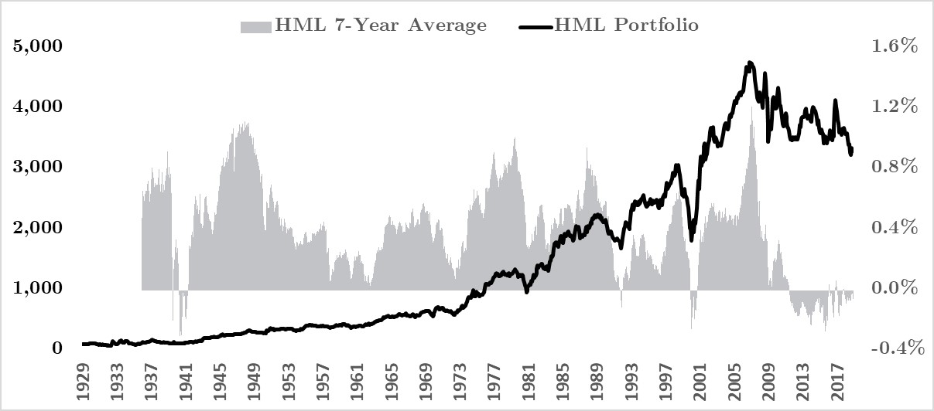
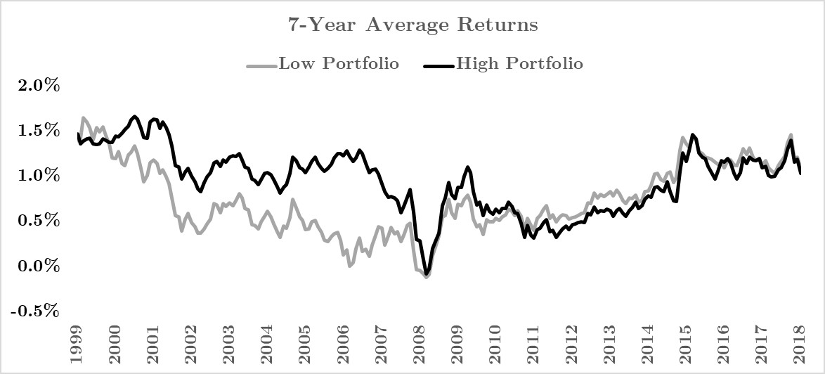
High Minus Low (HML) Factor
The HML factor was observed to exhibit mildly negative mean readings for the period between July 2011 and December 2018, though the HML factor's mean reading of -0.10% is deemed to be statistically indifferent from 0 at the 5% level.
The HML factor was seen to have displayed more consistently and persistently positive readings over the extended sample period of between January 1929 and December 2018 compared to the SMB factor.
This makes the unravelling of the HML factor's positive readings over the recent decade all the more an unprecedented one, which also explains the divergence between our observed mean HML and that of Fama and French (1993).
Our constructed HML portfolio has grossly outperformed our constructed SMB portfolio over the extended sample period in terms of nominal returns.
The HML portfolio clocked 3,200.59% returns while the SMB portfolio only clocked 500.96%, with the latter's Sharpe ratio coming up as negative for returns over the extended sample period.

Slide 40
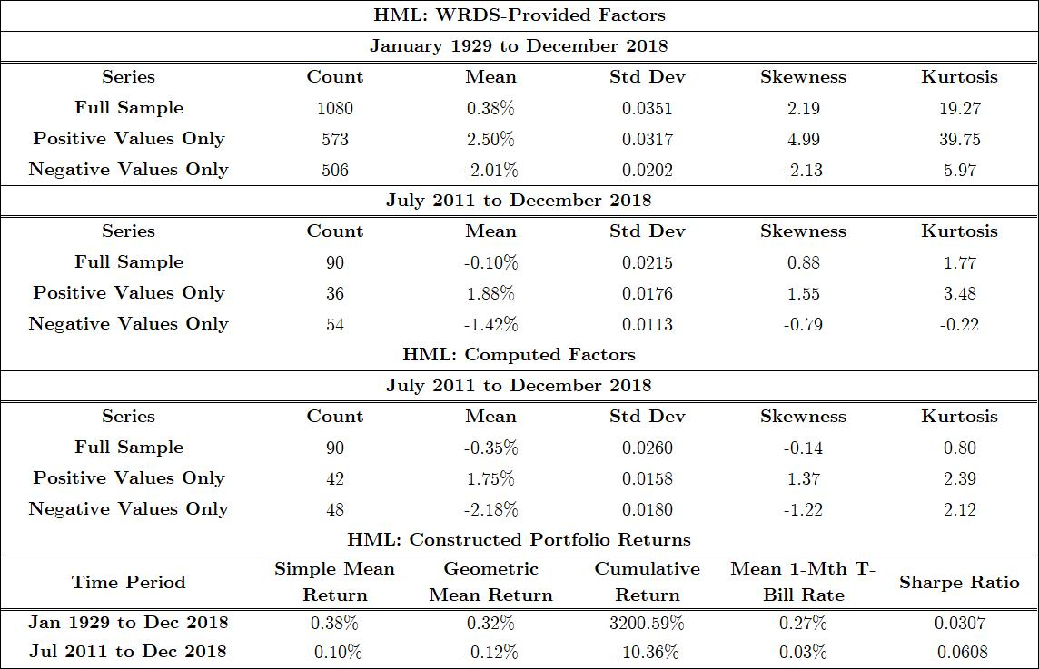
High Minus Low (HML) Factor

Slide 41
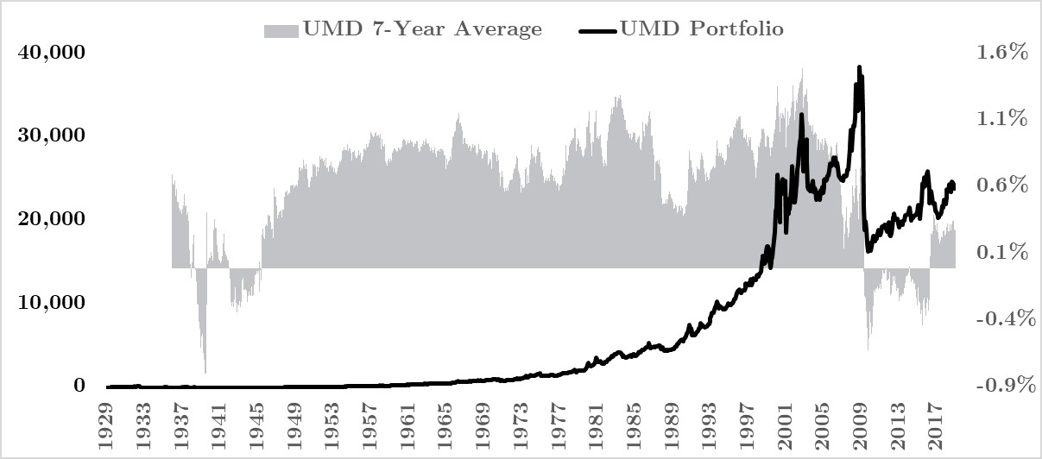
Bonus: Up Minus Down (UMD) Factor
We also looked at one of the additional stock market factors introduced and popularised by Carhart (1997): the momentum factor (UMD).
Like the HML factor, it was observed that the UMD factor is consistently and persistently positive.
Also, like the SMB and HML factors, we observed an unravelling of the long UMD play in the recent decade, though said unravelling took place relatively earlier from April 2009 and has already recovered since April 2016.
In terms of cumulative returns, the long UMD play has grossly outperformed both the long SMB play and the long HML play, with cumulative nominal returns of 24,252.43% observed over the extended sample period and 24.18% over the original sample period.
On a risk-adjusted basis and in terms of Sharpe ratios, the long UMD outperforms the long SMB play and the long HML play too.

Slide 42
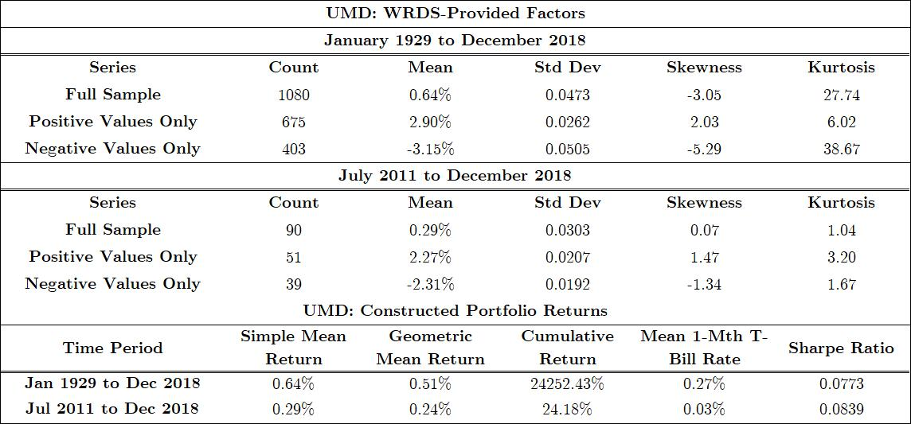
Bonus: Up Minus Down (UMD) Factor

Slide 43
Conclusion
7

Slide 44
Conclusion
Research Null Hypothesis Revisited:
The three stock-market factors suggested by Eugene F. Fama and Kenneth R. French in their 1993 paper titled “Common Risk Factors in the Returns on Stocks and Bonds” do not significantly explain the returns of stocks listed on the NYSE, NASDAQ and AMEX for the period between Jul 2011 – Dec 2018.
Conclusion: We Reject Our Research Null Hypothesis.
Additional Finding:
SMB factor turns negative in our testing period due to recent large cap relative outperformance.

Slide 45
References
8

Slide 46
Reference List
Markowitz, H. (1952). Portfolio selection. The Journal of Finance, 7(1), 77-91.
Sharpe, W. (1964). Capital asset prices: A theory of market equilibrium under conditions of risk. Journal of Finance, 19(3), 425-442.
Lintner, J. (1965). The valuation of risk assets and the selection of risky investments in stock portfolios and capital budgets. Review of Economics and Statistics, 47(1), 12-37.
Black, Fischer. Michael C. Jensen. and Myron Scholes. (1972). The capital asset pricing model: Some empirical tests. in: M. Jensen. ed.. Studies In the theory of capital markets (Praeger, New York, NY).
Fama, E., & French, K. (1993). Common risk factors in the returns on stocks and bonds.Journal of Financial Economics, 33(1), 3-56..
Fama. Eugene F. and Kenneth R. French. (1992a). The cross-section of expected stock returns.Journal of Finance 47, 427 - 465.
Banz. Rolf W.. 1981. The relationship between return and market value of common stocks, Journal of Financial Economics 9. 3-15.
Daniel, K., & Titman, S. (1997). Evidence on the characteristics of cross sectional variation in stock returns
Notes:
To prove fit of data for OLS

